Slide 1

EMPLOYEE MANAGEMENT SYSTEM
Project Supervisor : Ms. S. NITHYA, M.E
Name of the Student : VALLIAPPAN . L
Register Number : 39111054

Slide 2
Presentation Outline
Introduction
Objectives
Software and Hardware Configuration
Module Implementation
Application Snapshots
Conclusion
References

Slide 3
Introduction
The Project aims to build a EMPLOYEE MANAGEMENT SYSTEM system through which user can able to login and see their basic information and maintain the record according to authorisation.
Employee’s can not able to register themselves to login into the application , Employee’s are added and maintained only by the Admin or Manager.
Admin can maintain details of all employee in the organisation. but Manager can maintain only Employee’s detail only.

Slide 4
Objectives
The main objective of the project is to maintain the details of the all Employee in the organisation.
It Enhances the authentication visibility of details to every Employee
Easy and immediate online access

Slide 5
Software and Hardware Configuration
Software Requirements :
Nodejs must be installed with the recommended version
Angular CLI must be installed
Hardware Requirements :
Windows 10 OS
4 GB RAM or Above
10 GB free space on hard disk

Slide 6
Project Implementation
Install Angular cli.
Install Nodejs.
Create workspace and initialize application.
Create components and make their layout with HTML, CSS and JavaScript.
Build routes in between the components.
Connect the app to backend mongodb cluster.

Slide 7
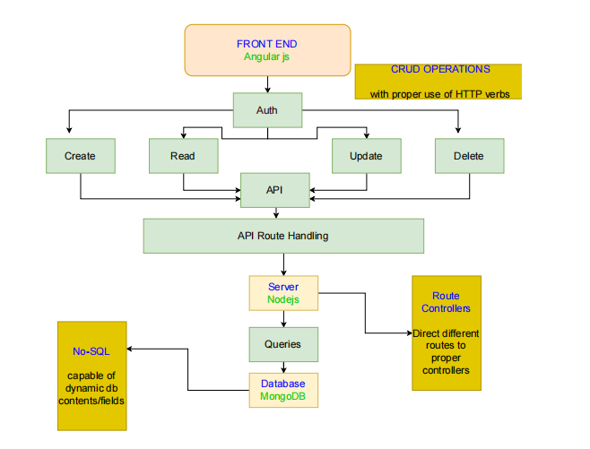
Module Implementation

Slide 8

Application Screenshot
Home Page

Slide 9
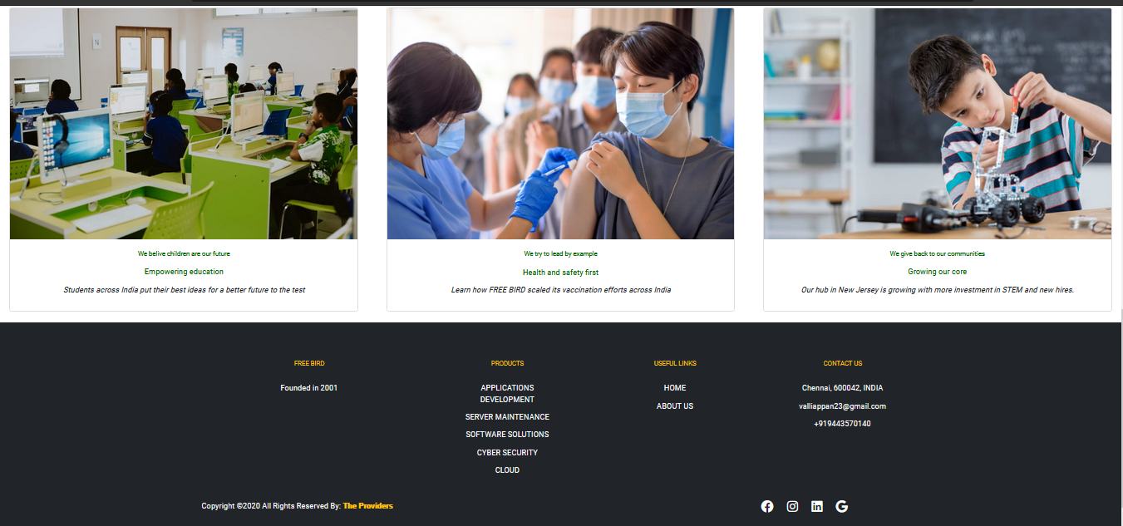
Application Screenshot
Home Page

Slide 10
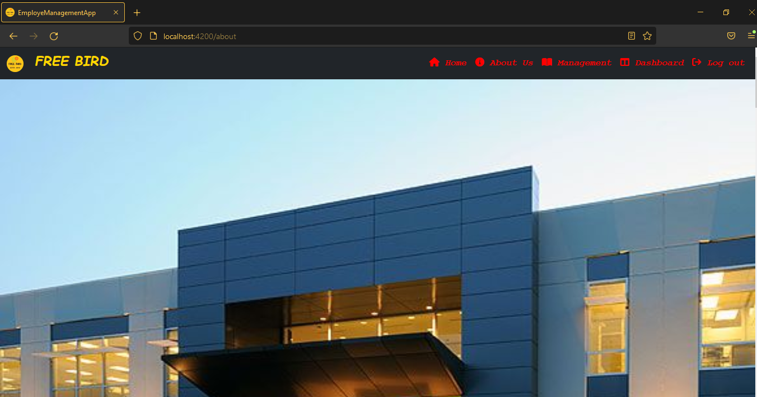
Application Screenshot
About Page

Slide 11
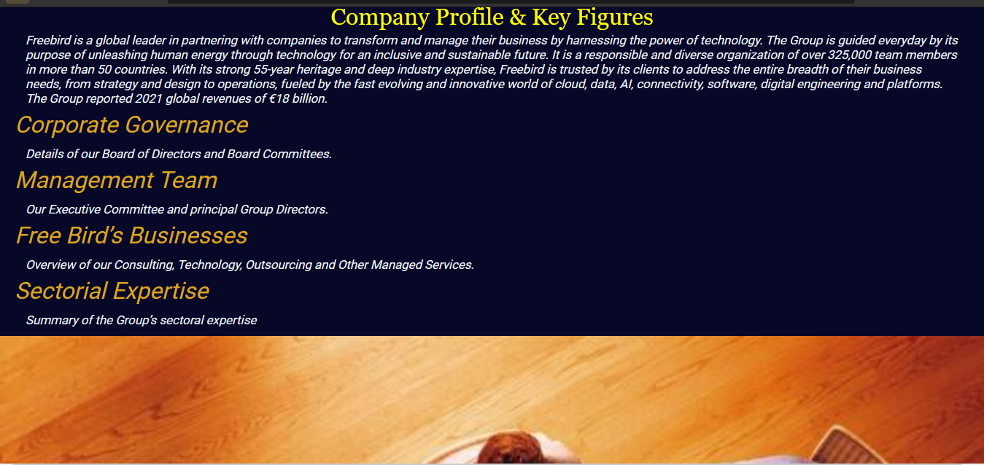
Application Screenshot
About Page

Slide 12
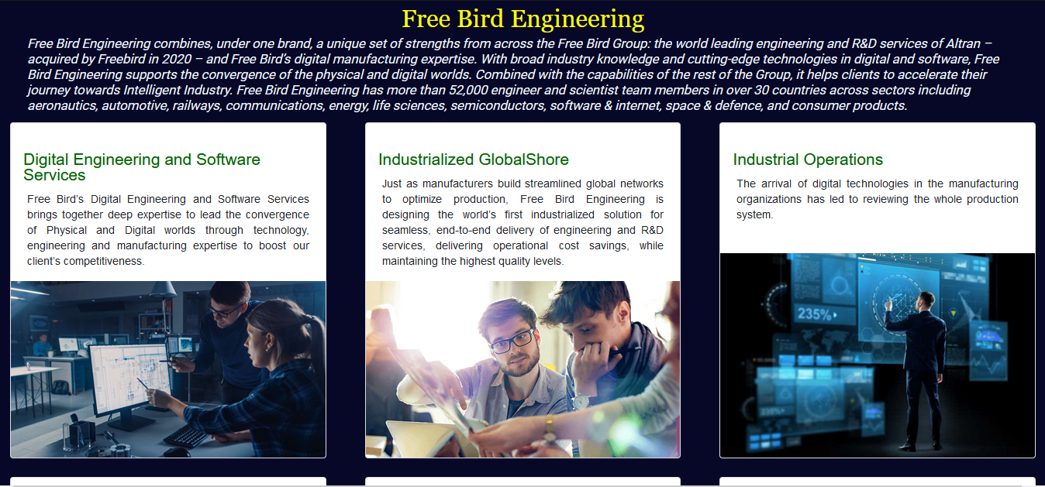
Application Screenshot
About Page

Slide 13
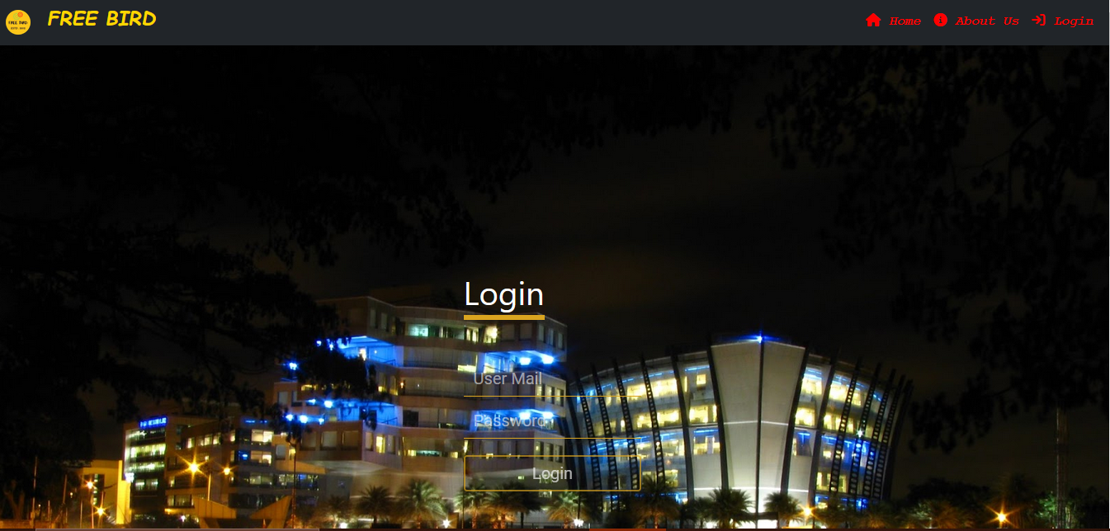
Application Screenshot
Login Page

Slide 14
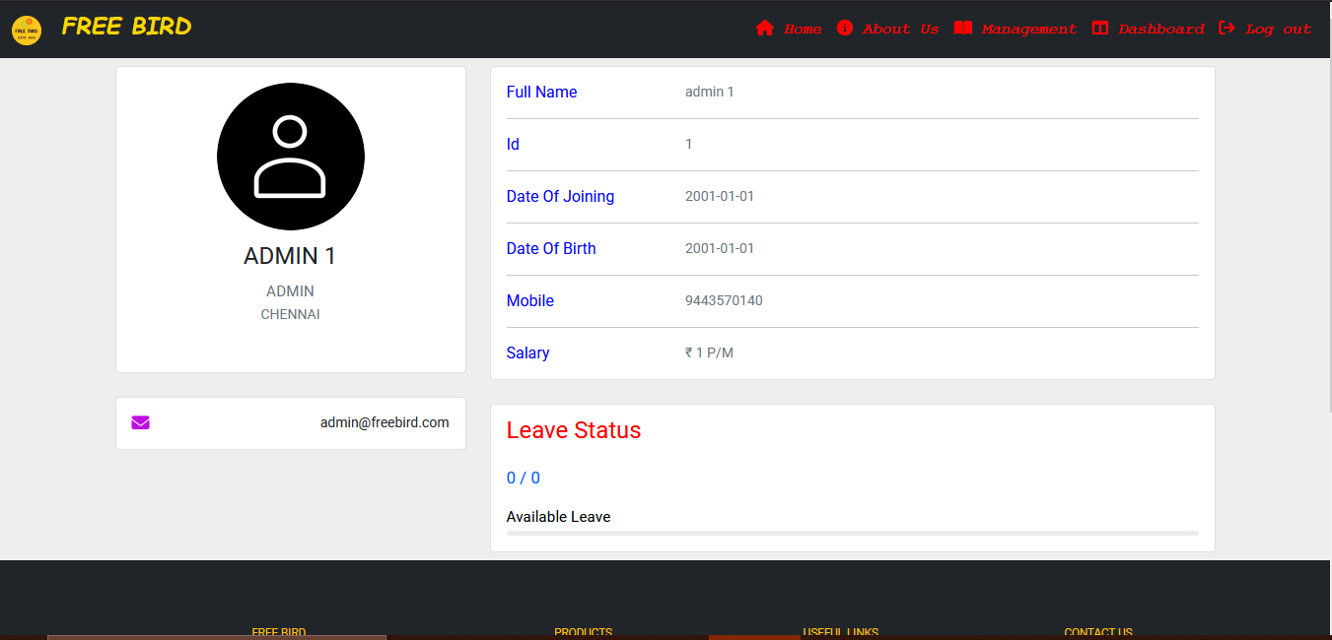
Application Screenshot
Dashboard Page Of Admin

Slide 15
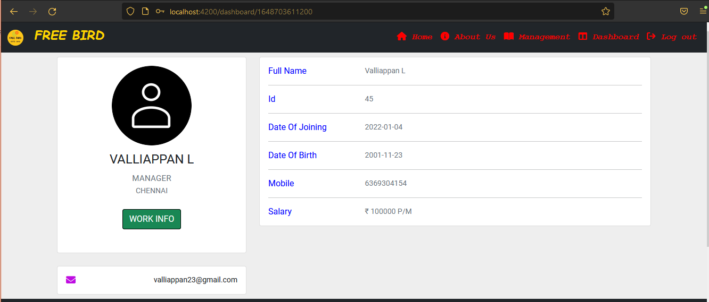
Application Screenshot
Dashboard Page Of Manager And Employee

Slide 16
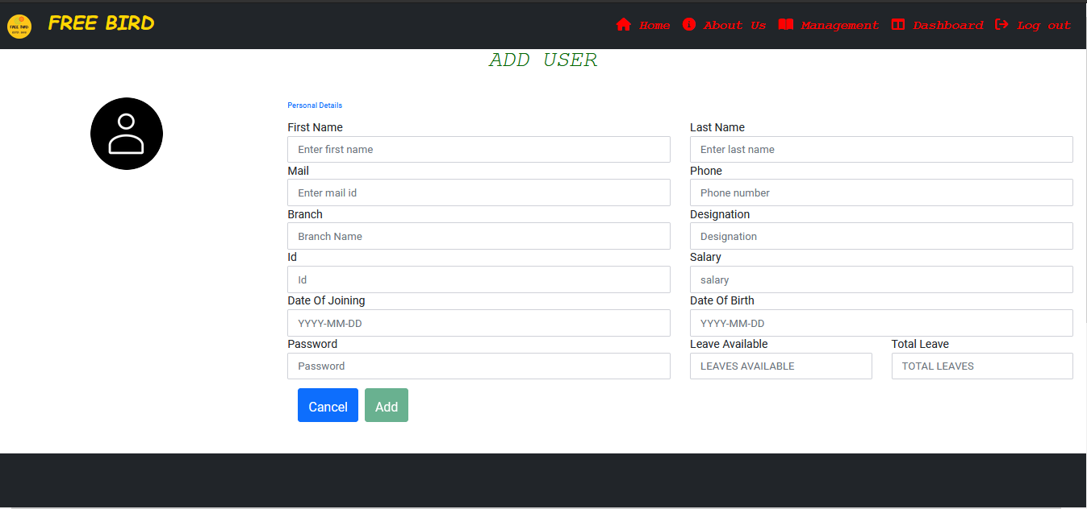
Application Screenshot
Add Post Page

Slide 17
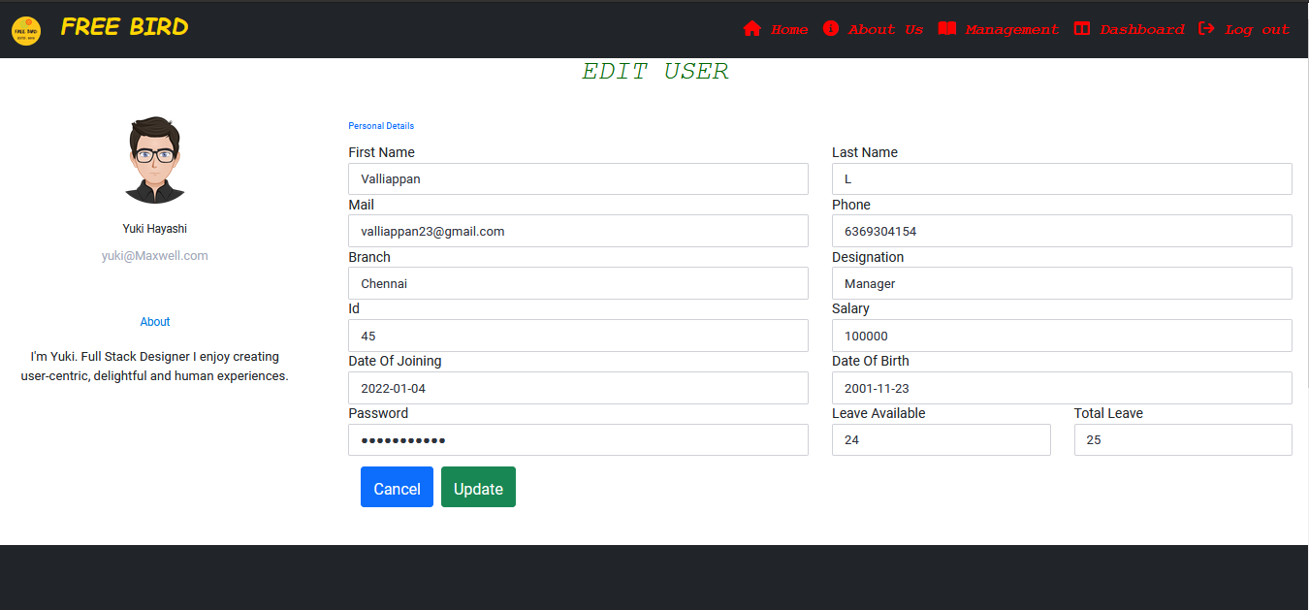
Application Screenshot
Edit Page

Slide 18
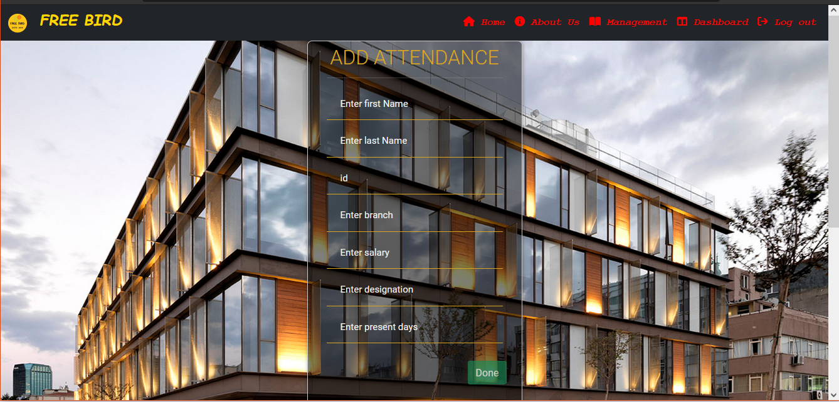
Application Screenshot
Add Attandance

Slide 19
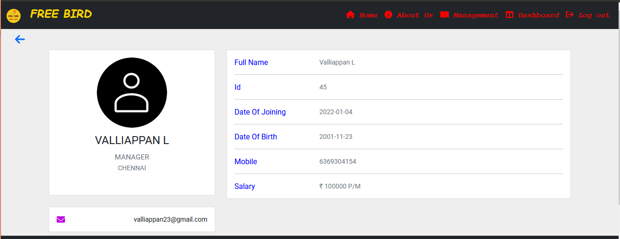
Application Screenshot
View Page

Slide 20
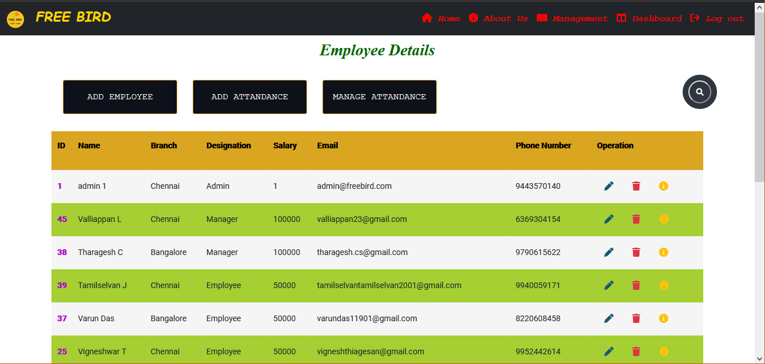
Application Screenshot
Management Page

Slide 21
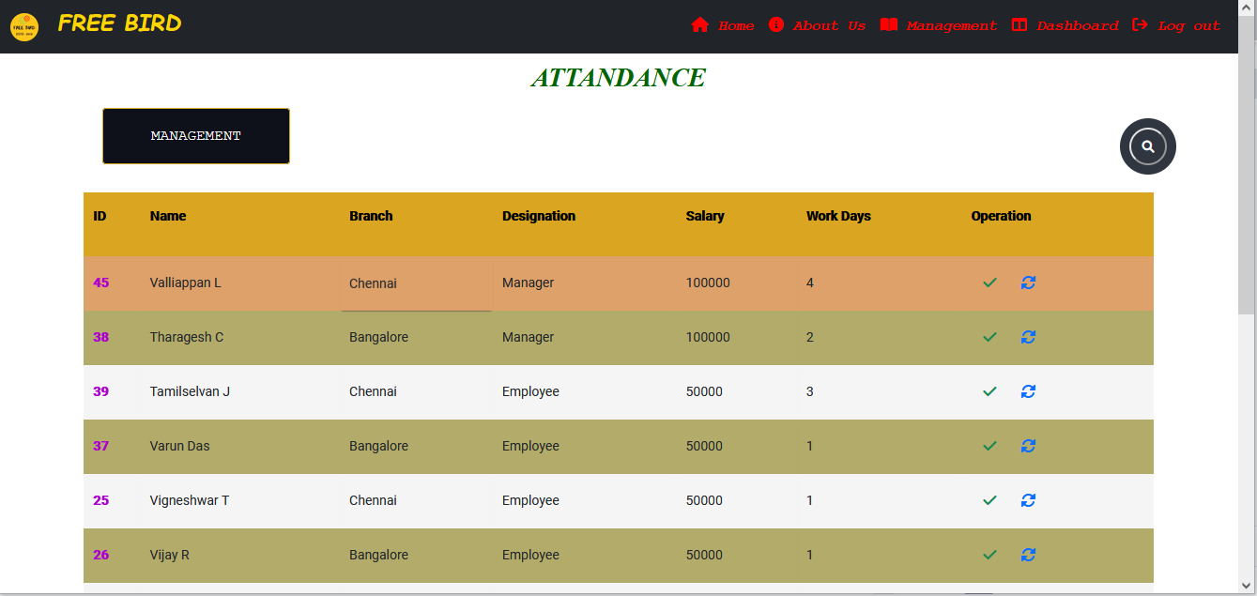
Application Screenshot
Manage Attandance Page

Slide 22
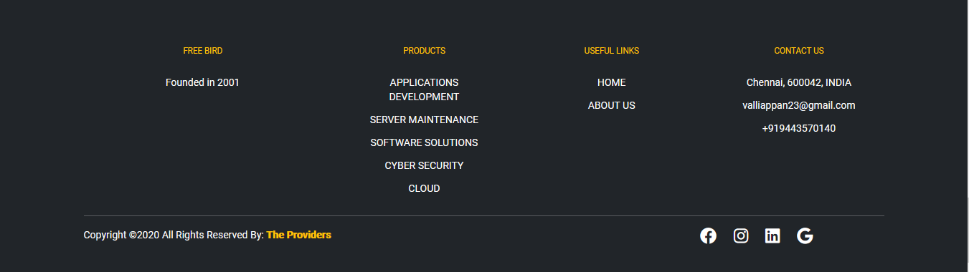
Application Screenshot
Footer Component

Slide 23
Conclusion
To summarize, a website is built using AngularJS Framework, with routing modules.
A secure Backend with quality authentication and API’s are built using ExpressJS.
The website allow users to log their tasks on the three categories.
The accessibility and responsiveness of the website, guarantee a large user base on various device levels.
Employee Management System helps to maintain the details of all employee and easy to accsess the data.
It helps in confidientiality and security of data
Delivers the required details of the employee to Admin, Manager and Employee.

Slide 24
References
https://getbootstrap.com/ https://fontawesome.com/ https://www.npmjs.com https://blog.hubspot.com/website/best-html5-admin-dashboard-templates https://www.mongodb.com/ https://nodejs.org/en/ https://angularjs.org/

